Slide 1

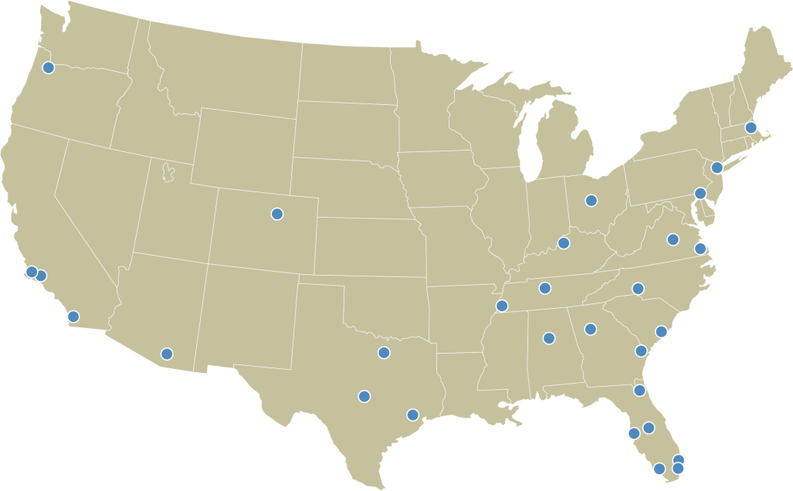

The Cushman & Wakefield
LAND PRACTICE GROUP
GROUP CONTACTS
THE CWLAND TEAM
ATLANTA, GA
Matt Hawkins | 404-853-5204 matt.hawkins@cushwake.com Pierce Owings | 404-853-5350 pierce.owings@cushwake.com Ron Willingham | 404-853-5206 ron.willingham@cushwake.com
AUSTIN, TX
Andrew Childers | 512-370-2444 achilders@oxfordcommercial.com
BIRMINGHAM, AL
Bill Pradat | 205-314-5526 bpradat@egsinc.com Deborah McGill | 205-314-5534 dmcgill@egsinc.com Mark Byers | 205-314-5522 mbyers@egsinc.com
BOSTON, MA
Richard Swartz | 617-204-5904 richard.swartz@cushwake.com
CHARLESTON, SC
John Coppedge | 843-724-01036 jcoppedge@coppedgetison.com
CHARLOTTE, NC
Warren Snowdon | 704-705-3852 warren.snowdon@thalhimer.com
COLUMBUS, OH
Jim Hendrix | 614-883-1095 JHendrix@continental-realty.com
DALLAS, TX
Drew Richardson | 972-663-9619 drew.richardson@cushwake.com Pete Richardson | 972-663-9629 pete.richardson@cushwake.com
DENVER, CO
Steve Hager | 303-813-6446 steve.hager@cushwake.com
EAST RUTHERFORD, NJ
Don Eisen | 201-460-3344 don.eisen@cushwake.com Jules Nissim | 201-460-3384 jules.nissim@cushwake.com Stan Danzig | 201-460-3388 stan.danzig@cushwake.com
FT. LAUDERDALE, FL
Brad Capas | 954-377-0505 brad.capas@cushwake.com Chris Metzger | 954-938-2608 chris.metzger@cushwake.com
FT. MYERS / NAPLES, FL
Gary Tasman | 239-489-3600 gtasman@cpswfl.com Shawn Stoneburner | 239-489-3600 sstoneburner@cpswfl.com
HOUSTON, TX
David Cook | 713-963-2888 david.cook@cushwake.com Jeff Peden | 713-963-2880 jeff.peden@cushwake.com Will Condrey | 713-963-2887 will.condrey@cushwake.com
JACKSONVILLE, FL
Logan Holz | 904-380-8346 logan.holz@cushwake.com
JACKSONVILLE, FL
Mark Scott | 904-380-8335 mark.scott@cushwake.com
LOS ANGELES, CA
Rooney Daschbach | 562-276-1431 rooney.daschbach@cushwake.com Steve Bohannon | 562-276-1400 steve.bohannon@cushwake.com
LOUISVILLE, KY
Sam English | 502-589-5150 senglish@commercialkentucky.com Phil Scherer | 502-589-5150 philscherer@commercialkentucky.com Robert Walker | 502-589-5150 Ext. 254 rwalker@commercialkentucky.com
MEMPHIS, TN
Jeff Barry | 901-362-4305 jbarry@commadv.com Chase Moore | 901-273-2355 cmoore@commadv.com Kemp Conrad | 901-273-2344 kconrad@commadv.com Larry Jensen | 901-362-4304 ljensen@commadv.com Matt Weathersby | 901-362-4317 mweathersby@commadv.com
MIAMI, FL
Greg Masin | 305-533-2857 greg.masin@cushwake.com Rosendo Caveiro | 305-533-2877 rosendo.caveiro@cushwake.com Wayne Ramoski | 305-533-2840 wayne.ramoski@cushwake.com
NASHVILLE, TN
Brent Basham | 615-727-7406 bbasham@cornerstonecres.com Buck Haltiwanger | 615-727-7410 bhaltiwanger@cornerstonecres.com Warren Smith | 615-727-7409 wsmith@cornerstonecres.com
NORFOLK / VIRGINIA BEACH, VA
William (Bill) Throne | 757-499-2692 x.1682 bill.throne@thalhimer.com Robert Thornton | 757-499-0583 robert.thornton@thalhimer.com
ORANGE COUNTY, CA
Jeff Chiate | 949-474-4004 jeff.chiate@cushwake.com
ORLANDO, FL
Margery Johnson | 407-841-8000 margery.johnson@cushwake.com
PORTLAND, OR
Skip Rotticci | 503-279-1744 skip.rotticci@cushwake.com
RICHMOND, VA
Evan Magrill | 804-697-3435 evan.magrill@thalhimer.com David Smith | 804-697-3466 david.smith@thalhimer.com
SAN DIEGO, CA
Gale Bucciarelli | 858-558-5612 gale.bucciarelli@cushwake.com Matt Marschall | 858-558-5626 matt.marschall@cushwake.com Terry Jackson | 858-558-5685 terry.jackson@cushwake.com
SAVANNAH, GA
Bill Lattimore | 912-220-1433 blattimore@glcre.com Harvey Gilbert | 912-547-4012 hgilbert@glcre.com
TAMPA, FL
Bruce Erhardt | 813-223-6300 bruce.erhardt@cushwake.com Patrick Berman | 813-223-6300 patrick.berman@cushwake.com
TUCSON, AZ
Peter Douglas | 520-546-2711 pdouglas@picor.com
WILMINGTON, DE
Ernie Felici, Jr. | 302-655-9621 ernie.felici@cushwake.com John Birmingham | 302-655-9621 john.birmingham@cushwake.com
Creating solutions for land
buyers and sellers
Creating solutions for land
buyers and sellers
Bruce K. Erhardt, ALC CWLAND Team Leader Cushman & Wakefield of Florida, Inc. One Tampa City Center, Suite 3600 Tampa, Florida 33602 813.223.6300 cushmanwakefield.com

Slide 2

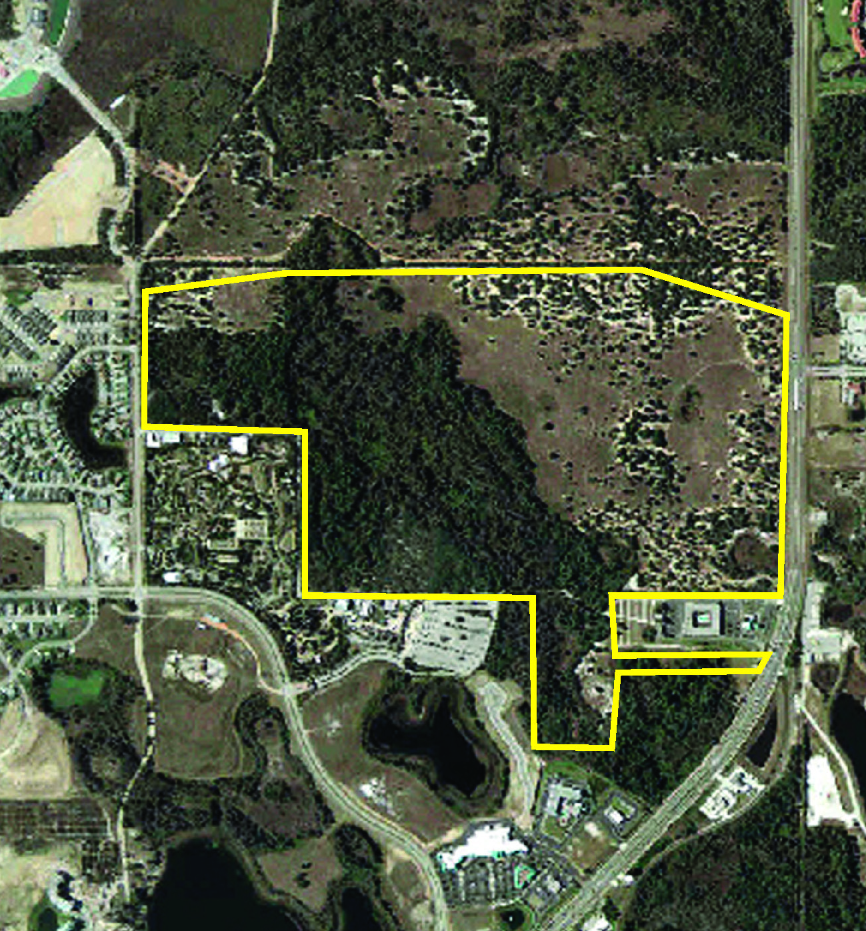
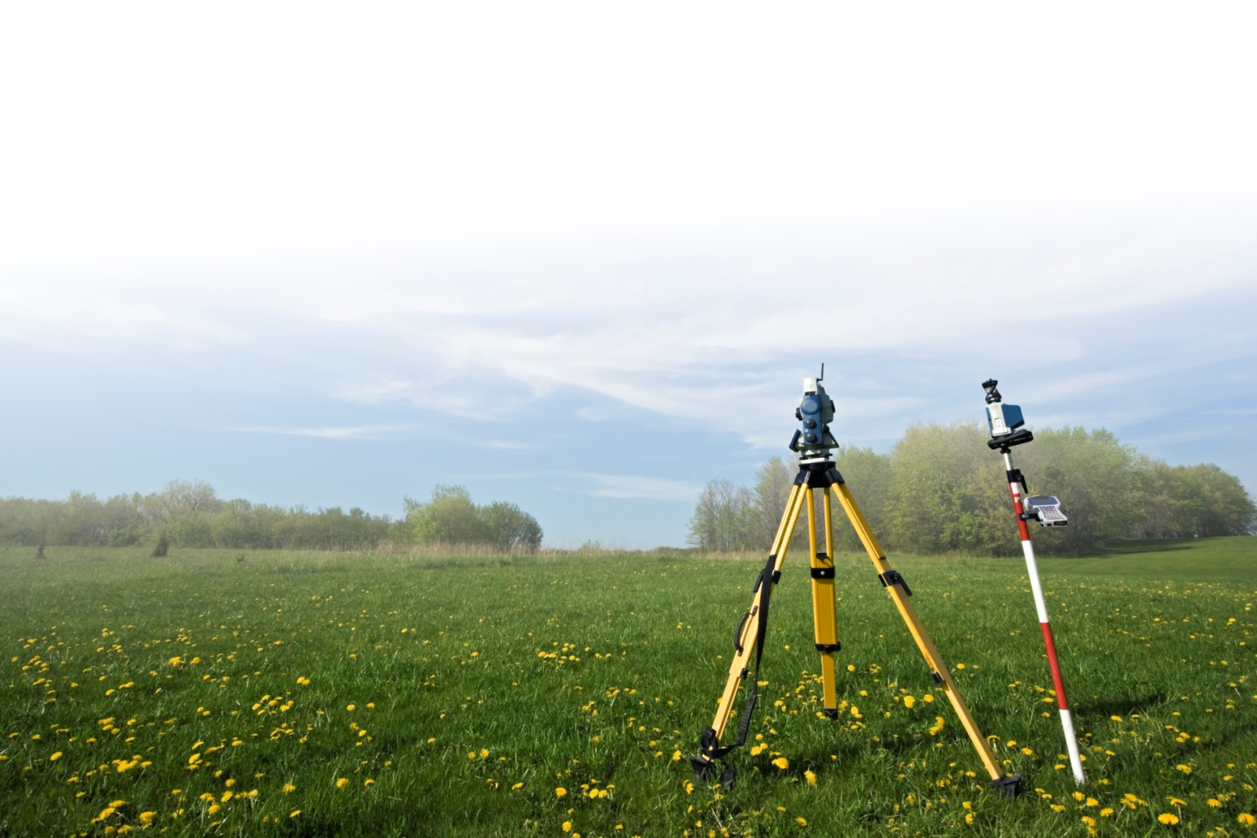

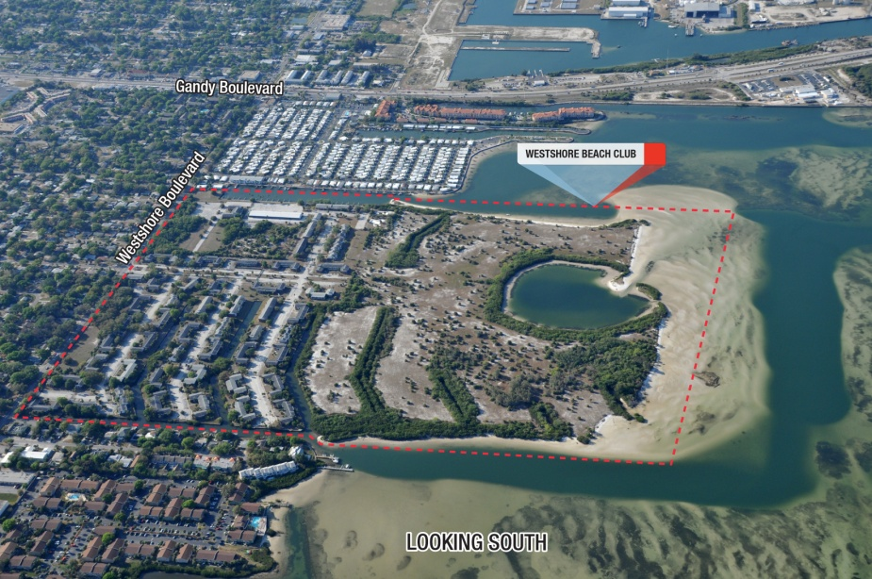
THE TEAM
FOR LAND OWNERS, BUYERS & DEVELOPERS
The CWLAND team has immediate access to key market data, including sales data critical to determining and executing solutions for complex land situations.
BENEFITS OF THE CWLAND TEAM
Proven approach – Dealing with firm founded in 1917. Experience – Experienced land professionals working as an integrated team, with other C&W disciplines, who have been through prior cycles and have incorporated that knowledge to perfect this multifaceted approach. Access to real time market data – We offer immediate access to proprietary market statistics, leasing, operating and sales data enabling rapid and accurate decisions. Speed to market – CWLAND executes quickly. International coverage – 234 Offices in 61 countries. Local expertise – Skilled professionals implementing strategies locally. With over 113 locations, C&W blankets the United States. CWLAND brings each client a fully-integrated team, providing all required services, directed by a senior professional with strong land brokerage experience.
THE CUSHMAN & WAKEFIELD LAND PRACTICE GROUP (CWLAND)…
…brings together teams of seasoned and knowledgeable professionals who have expertise in all aspects of buying and selling. These teams use their substantial experience and proprietary real-time local market information to analyze and develop appropriate strategies for individual sites or portfolios. By capitalizing on various resources within the company, C&W is uniquely qualified to combine local real estate knowledge with experience in international and domestic capital markets through Cushman & Wakefield Sonnenblick Goldman (CWSG).
SERVICES PROVIDED INCLUDE
Site Selection / Disposition Assemblage Auction Marketing Valuation Financial Analysis REO / Advisory Services Asset Management Financing through CWSG Port Land Expertise CBD to Agricultural Land
POSITION SHORT-TERM
Short-term asset management strategy Due diligence
ASSET STRATEGY
Valuation Hold versus sell analysis and alternatives / recommendations Sensitivity analysis
FINANCIAL RESOLUTION
Sell the asset Refinance Joint venture
HOLD LONG-TERM
Perform due diligence Create long-term asset management strategy Reduce taxes Institute property management program Determine income potential
HISTORIC TRANSACTIONS
United Nations Land Assemblage | Sea Island Company Represented by C&W in the sale of historic coastal land totaling 19,572 acres along Georgia’s picturesque southeastern coast | China owned China Travel Services, Former Splendid China Theme Park Land disposition
 |  | C&W has a long history of significant land transactions, such as the assemblage for the United Nations and the Sears Tower sites, and the sale of 19,572 acres in southeast Georgia for the Sea Island Company. Since 2006, C&W has closed 1,078 land transactions totaling 75,193.64 acres, valued at over $6.7 billion. Over the past five years, CWSG has financed over $25 billion of development loans.
Sears Tower Land Assemblage | Former Georgetown Apartment Site, Tampa Land disposition for Bank of America

